Slide 2
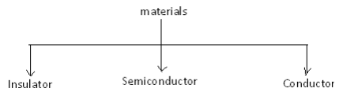
Semiconductor Diode
Based on the electrical conductivity, all the materials in nature are classified as insulators, semiconductors, and conductors

Slide 3
A semiconductor is a material which has electrical conductivity to a degree between that of a metal (such as copper) and that of an insulator (such as glass).
Semiconductors are the foundation of modern electronics, including transistors, solar cells, light-emitting diodes (LEDs), quantum dots and digital and analog integrated circuits.

Slide 4
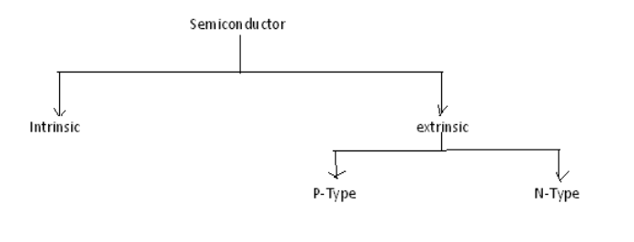
Semiconductor Types

Slide 5
A semiconductor material in its pure form is known as an intrinsic semiconductor. Thus, the intrinsic semiconductors are chemically pure, i.e. they are free from impurities
When a small amount of chemical impurity is added to an intrinsic semiconductor, then the resulting semiconductor material is known as extrinsic semiconductor
Based on the type of doping, the extrinsic semiconductors are classified into two types viz. N-type semiconductors and P-type semiconductors

Slide 6
When a pentavalent impurity is added to an intrinsic semiconductor, then the resulting semiconductor is termed as N-type semiconductor.
On the other hand, when a trivalent impurity is added to a pure semiconductor, then the obtained semiconductor is known as P-type semiconductor.

Slide 7
P-N Junction
A p-n junction is formed by joining p-type and n-type semiconductors together in very close contact
The term junction refers to the boundary interface where the two regions of the semiconductor meet.
In a piece of semiconductor material if one half is dopped by p type impurity and other half is dopped by n type then PN junction is formed

Slide 8
In a n type material has high concentration of free electronics
p type material has high concentration of free holes
At junction there is a tendency for electrons to diffuse from n to p,this process is called diffusion
As free electrons moves from n to p the donor ions become positively charged,hence positive charge is built on the n side of the junction
Hence negative charge is built on the p side of the junction
The net negative charge on the p side prevents the diffusion of electrons fron n to p

Slide 9
Similarly the positive charge on the n side prevents the holes passing from p to n
Therefore a barrieris set up near the junction which prevents the movement of charge carriers either electrons or holes
This is called depletion region,the electro static potential at this junction is called as barrier potential
the barrier potential for Ge is 0.3V and for Si is 0.6V
The width of depletion region depends on doping

Slide 10
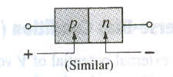
Schematic arrangement of PN junction diode

Slide 11

Symbol of PN junction diode

Slide 12
The term Bias refers to the application of external voltage across the two terminals of the device to extract the response.
We have two different biasing conditions:
Forward Bias
Reverse Bias

Slide 13
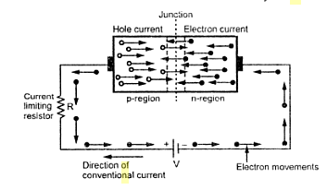
Forward biased PN junction

Slide 14
If the positive terminal of the battery is connected to the p region and negative terinal of the battery is connected to the n region then that biasing is called as forward bias
Operation
When p-n junction is in forward bias as long as the applied voltage is less than the barrier potential,then there is no current with in the semi conductor p n Junction diode
When applied voltage becomes greater than the barrier potential,the negative terminal of the battery pushes the electrons against the barrier potential from n to p
Similarly positive terminal of the battery pushes the holes against the barrier potential from p to n
Thus the applied external voltage overcomes the barrier potential,then it reduces the width of the depletion region

Slide 15
Then large number of majority carriers can cross the junction(holes crossing from p to n ,electrons crossing from n to p)
These large number of majority carriers constitutes a current known as forward current
In p region the current is due to moment of holes which are majority carrier this is called a hole current
In n region the current is due to moment of electrons which are majority carrier this is called a electron current
The over all forward current is due to both hole current and electron current

Slide 16
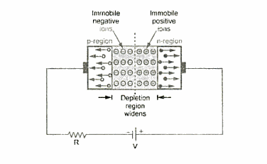
Reverse biased PN junction

Slide 17
When the negative terminal of the battery is connected to the p type
And positive terminal of the battery is connected to the n type the bias is called reverse bias
Operation:
Under reverse bias the holes which are majority carriers of the p side moves towards the negative terminal of the battery
Electrons which are majority carriers of n side moves towards the positive terminal of the battery
Hence width of the depletion region increases and also potential barrier increases which prevents the flow of majority carriers in both directions

Slide 18
Theoritically no current flows in the circuit
But practically small current in order of micro ampers or nano ampers
Under reverse bias exsists

Slide 19
At certain voltage to the barrier potential the current increases rapidly
The voltage at which current starts increases is called as cutin voltage
The cutin voltage for Ge is 0.2 or 0.3V
For Si is 0.6 or 0.7V

Slide 20
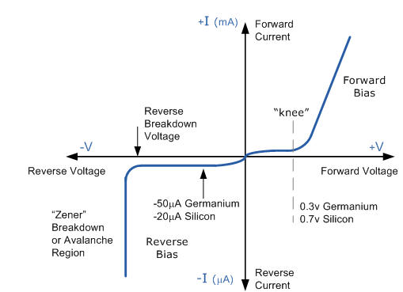
V-I Characteristics of PN junction diode

